Slide 1

Bath Soup Consumers Segmentation
By: Hadeer Elmahdy

Slide 2
Bath Soap Problem & Goal
CRISA is trying to create a marketing analysis that can identify Bath Soup consumers segments(based on their demographics, purchase behaviors and basis of purchase).
The Target is to create customized advertising and promotional campaign(3-5) that will target those segments.

Slide 3
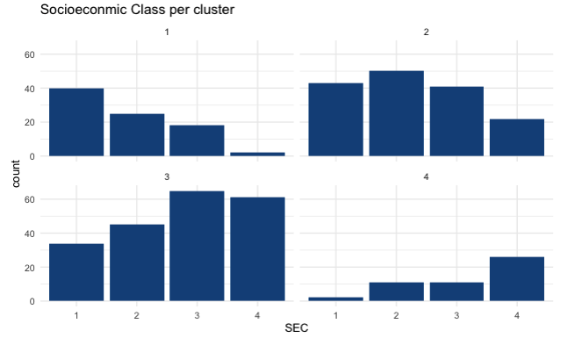
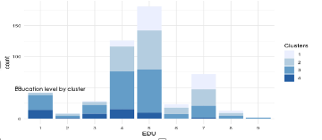
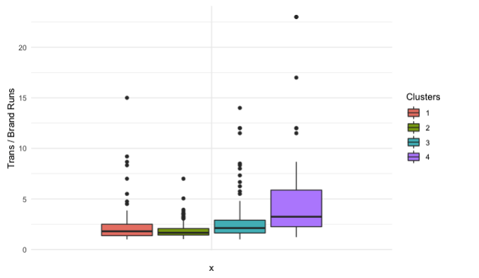
Segmentation Results & Insights
Segment 1
Low socioeconomics class – lowest total purchase volume
Segment 2
Mixed Socioeconomics class -Highest number of transactions and number of brands – Highest purchase value – Older age group - high education – highest volume with promo 6%
Segment 3
Highest Socioeconomics class – high purchase volume – Highest education level – high volume with no promo – high ratio of transactions to brand runs
Segment 4
Highest total volume- highest ratio of transactions to brand runs – Highest volume with no promo
Education level by cluster
Trans/ brand runs Ratio

Slide 4
Conclusion
CRISA should target customers in segment 2 for promotions:
A diverse socioeconomic class allowing CRISA to gain a variety of demographic attributes.
highest number of transactions.
The highest volume of purchases.
The highest purchases of value.

